Slide 1
Credit card approval predictor
Supervised Machine Learning

Slide 2
Description
Commercial banks receive a lot of applications for credit cards. Many of them get rejected for many reasons, like high loan balances, low-income levels, or too many inquiries on an individual's credit report, etc. Manually analyzing these applications is boring, error-prone, and time-consuming (and time is money!).
Luckily, this task can be automated with the power of machine learning and pretty much every commercial bank does so nowadays. In this example, a credit card approval predictor using machine learning techniques will be produced, just like the real banks do.

Slide 3
Data set
The dataset used in this exercise is the Credit Card Approval dataset from the UCI Machine Learning Repository.
The filename is cc_approvals.data (although its extension is .data, the file format is .csv)
Two different approaches.
Approach 1 – Clean and Split
Approach 2 – Split and Clean

Slide 4
APPROACH 1
Load and Explore
Clean – both numeric and categorical
Split
Fit
Predict

Slide 5
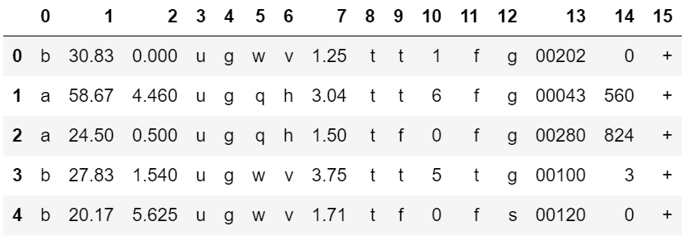
STEP 1: Loading and Exploring
First, we will start off by loading and viewing the dataset.
We will see that the dataset has a mixture of both numerical and non-numerical features, that it contains values from different ranges, plus that it contains missing entries.
We will have to preprocess the dataset to ensure the machine learning model we choose can make good predictions.
After our data is in good shape, we will do some exploratory data analysis to build our intuitions.
Finally, we will build a machine learning model that can predict if an individual's application for a credit card will be accepted.
First, loading and viewing the dataset. We find that since this data is confidential, the contributor of the dataset has anonymized the feature names (column names are not available).
# Import pandas
import pandas as pd
cc_apps = pd.read_csv("cc_approvals.data", header=None)
cc_apps.head()

Slide 6
STEP 2: Inspecting the applications
The output may appear a bit confusing at its first sight, but let's try to figure out the most important features of a credit card application. The features of this dataset have been anonymized to protect the privacy, but this blog gives us a pretty good overview of the probable features.
The probable features in a typical credit card application are Gender, Age, Debt, Married, BankCustomer, EducationLevel, Ethnicity, YearsEmployed, PriorDefault, Employed, CreditScore, DriversLicense, Citizen, ZipCode, Income and finally the ApprovalStatus. This gives us a pretty good starting point, and we can map these features with respect to the columns in the output.
As we can see from our first glance at the data, the dataset has a mixture of numerical and non-numerical features. This can be fixed with some preprocessing, but before we do that, let's learn about the dataset a bit more to see if there are other dataset issues that need to be fixed.

Slide 7
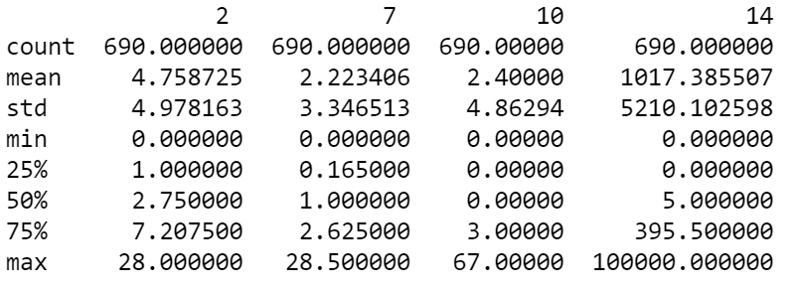
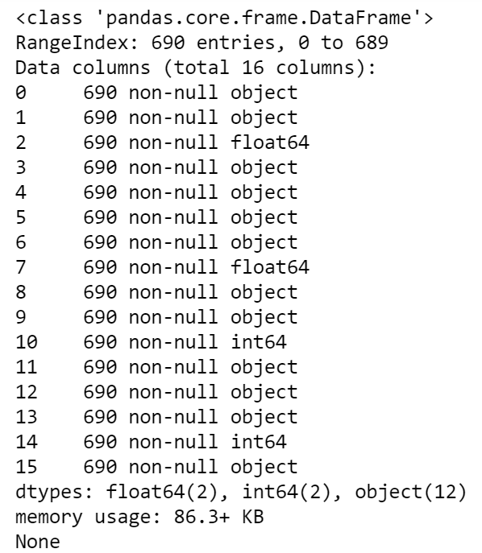
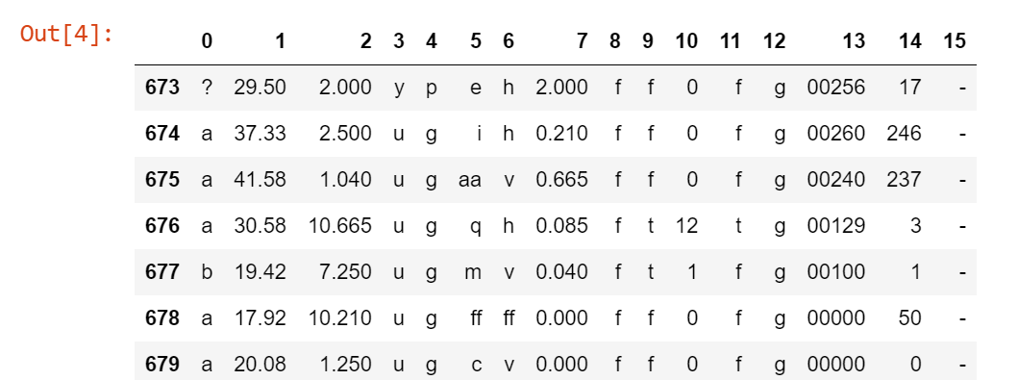
Inspecting the applications
As we can see from our first glance at the data, the dataset has a mixture of numerical and non-numerical features. This can be fixed with some preprocessing, but before we do that, let's learn about the dataset a bit more to see if there are other dataset issues that need to be fixed. What shall we do?
Printing summary statistics.
Print DataFrame information.
Inspect missing values.
print(cc_apps.describe())
print('\n')
print(cc_apps.info())
print('\n')
cc_apps.tail(17) # or cc_apps.sample()

Slide 8
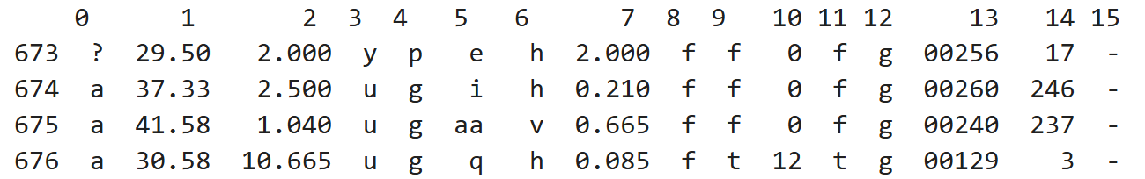
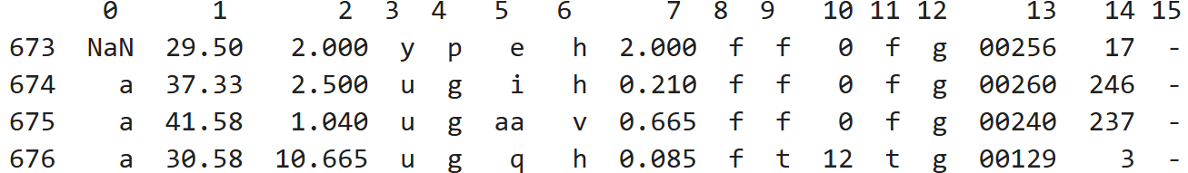
STEP 3: Handling Missing Values (Part 1)
Our dataset contains both numeric and non-numeric data (specifically data that are of float64, int64 and object types). Specifically, the features 2, 7, 10 and 14 contain numeric values (of types float64, float64, int64 and int64 respectively) and all the other features contain non-numeric values.
The dataset also contains values from several ranges. Some features have a value range of 0 - 28, some have a range of 2 - 67, and some have a range of 1017 - 100000. Apart from these, we can get useful statistical information (like mean, max, and min) about the features that have numerical values.
Finally, the dataset has missing values, which we'll take care of in this task. The missing values in the dataset are labeled with '?', which can be seen in the last cell's output.
# Import numpy
import numpy as np
# Inspect missing values in the dataset
print(cc_apps.tail(17))
# Replace the '?'s with NaN
cc_apps = cc_apps.replace('?', np.nan)
# Inspect the missing values againprint
(cc_apps.tail(17))

Slide 9
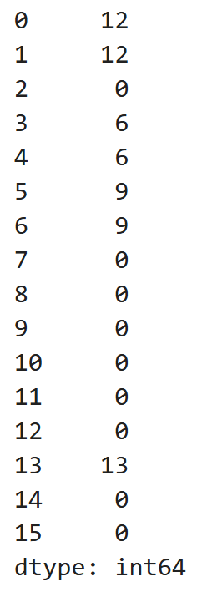
STEP 3: Handling Missing Values (Part 2)
We replaced all the question marks with NaNs. This is going to help us in the next missing value treatment that we are going to perform.
An important question that gets raised here is why are we giving so much importance to missing values? Can't they be just ignored? Ignoring missing values can affect the performance of a machine learning model heavily. While ignoring the missing values our machine learning model may miss out on information about the dataset that may be useful for its training. Then, there are many models which cannot handle missing values implicitly such as LDA.
So, to avoid this problem, we are going to impute the missing values with a strategy called mean imputation.
# Impute the missing values with mean imputation
cc_apps.loc[[2,7,10,14]].fillna(np.mean, inplace=True)
# Count the number of NaNs in the dataset to verify
print(cc_apps.isna().sum())

Slide 10
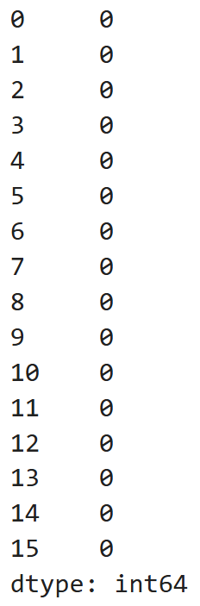
STEP 3: Handling Missing Values (Part 3)
We have successfully taken care of the missing values present in the numeric columns. There are still some missing values to be imputed for columns 0, 1, 3, 4, 5, 6 and 13. All of these columns contain non-numeric data and this why the mean imputation strategy would not work here. This needs a different treatment.
We are going to impute these missing values with the most frequent values as present in the respective columns. This is good practice when it comes to imputing missing values for categorical data in general.
# Iterate over each column of cc_apps
for col in list(cc_apps):
# Check if the column is of object type
if cc_apps[col].dtypes == 'object':
# Impute with the most frequent value
cc_apps = cc_apps.fillna(cc_apps[col].value_counts().index[0])
elif cc_apps[col].dtypes == 'int':
cc_apps = cc_apps.fillna(np.mean, inplace=True)
# Count the number of NaNs in the dataset and print the counts to verify print(cc_apps.isna().sum())

Slide 11
STEP 4: Preprocessing the data (Part 1)
The missing values are now successfully handled.
There is still some minor but essential data preprocessing needed before we proceed towards building our machine learning model. We are going to divide these remaining preprocessing steps into three main tasks:
Convert the non-numeric data into numeric.
Split the data into train and test sets.
Scale the feature values to a uniform range.
First, we will be converting all the non-numeric values into numeric ones. We do this because not only does it result in faster computation, but also many machine learning models (and especially the ones developed using scikit-learn) require the data to be in a strictly numeric format. We will do this by using a technique called label encoding.
# Import LabelEncoder
from sklearn.preprocessing import LabelEncoder
# Instantiate LabelEncoder
le = LabelEncoder()
# Iterate over all the values of each column and extract their dtypes
for col in list(cc_apps):
# Compare if the dtype is object
if cc_apps[col].dtypes=='object':
# Use LabelEncoder to do the numeric transformation cc_apps[col]=le.fit_transform(cc_apps[col])

Slide 12
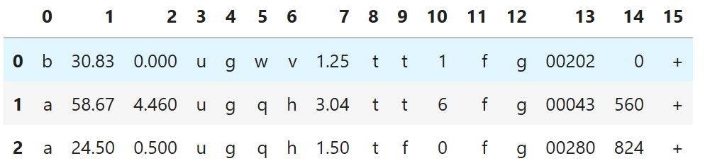
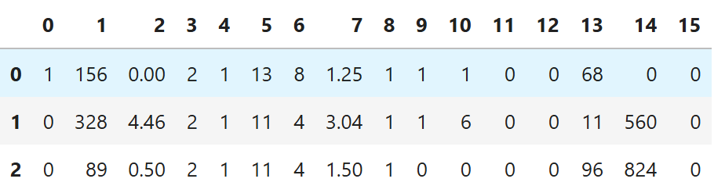
Before Encoding
After Encoding

Slide 13
STEP 5: Train-test split
We have successfully converted all the non-numeric values to numeric ones.
Now, we will split our data into train set and test set to prepare our data for two different phases of machine learning modeling: training and testing. Ideally, no information from the test data should be used to scale the training data or should be used to direct the training process of a machine learning model. Hence, we first split the data and then apply the scaling.
Also, features like DriversLicense (11) and ZipCode (13) are not as important as the other features in the dataset for predicting credit card approvals. We should drop them to design our machine learning model with the best set of features. In Data Science literature, this is often referred to as feature selection.

Slide 14
STEP 5: Train-test split
# Import train_test_split
from sklearn.model_selection import train_test_split
# Drop the features 11 and 13 and convert the DataFrame to a NumPy array
cc_apps = cc_apps.drop([11,13], axis=1)
cc_apps = cc_apps.values
# Segregate features and labels into separate variables
X,y = cc_apps[:,0:12] , cc_apps[:,13]
# Split into train and test sets
X_train, X_test, y_train, y_test = train_test_split(X, y, test_size=0.33, random_state=42)
print(X_train.shape, y_train.shape)
print(X_test.shape, y_test.shape)

Slide 15
STEP 6: Scaling
The data is now split into two separate sets - train and test sets respectively. We are only left with one final preprocessing step of scaling before we can fit a machine learning model to the data.
Now, let's try to understand what these scaled values mean in the real world. Let's use CreditScore as an example. The credit score of a person is their creditworthiness based on their credit history. The higher this number, the more financially trustworthy a person is considered to be. So, a CreditScore of 1 is the highest since we're rescaling all the values to the range of 0-1.
# Import MinMaxScaler
from sklearn.preprocessing import MinMaxScaler
# Instantiate MinMaxScaler and use it to rescale X_train and X_test
scaler = MinMaxScaler(feature_range=(0, 1))
rescaledX_train = scaler.fit_transform(X_train)
rescaledX_test = scaler.fit_transform(X_test)
print(rescaledX_train.shape)
print(rescaledX_test.shape)

Slide 16
STEP 7: FIT THE MODEL
Essentially, predicting if a credit card application will be approved or not is a classification task. According to the owner of this data set, UCI, our dataset contains more instances that correspond to "Denied" status than instances corresponding to "Approved" status. Specifically, out of 690 instances, there are 383 (55.5%) applications that got denied and 307 (44.5%) applications that got approved..
Now, let's try to understand what these scaled values mean in the real world. Let's use CreditScore as an example. The credit score of a person is their creditworthiness based on their credit history. The higher this number, the more financially trustworthy a person is considered to be. So, a CreditScore of 1 is the highest since we're rescaling all the values to the range of 0-1.
# Import LogisticRegression
from sklearn.linear_model import LogisticRegression
# Instantiate a LogisticRegression classifier with default parameter values
logreg = LogisticRegression() #solver='lbfgs’
# Fit logreg to the train set
logreg.fit(rescaledX_train,y_train)

Slide 17
STEP 8: Prediction and evaluation
We will now evaluate our model on the test set with respect to classification accuracy. But we will also take a look the model's confusion matrix. In the case of predicting credit card applications, it is equally important to see if our machine learning model is able to predict the approval status of the applications as denied that originally got denied. If our model is not performing well in this aspect, then it might end up approving the application that should have been approved. The confusion matrix helps us to view our model's performance from these aspects.
# Import confusion_matrix
from sklearn.metrics import confusion_matrix
from sklearn.metrics import accuracy_score
# Use logreg to predict instances from the test set and store it
y_pred = logreg.predict(rescaledX_test)
# Get the accuracy score of logreg model and print it
print("Accuracy of logistic regression classifier: ", accuracy_score(y_test,y_pred))
# Print the confusion matrix of the logreg model
print(confusion_matrix(y_test,y_pred))

Slide 18
APPROACH 2
Load and Explore
Split
Clean – both numeric and categorical
Fit
Predict

Slide 19
STEP 1: Loading and Exploring
First, we will start off by loading and viewing the dataset.
We will see that the dataset has a mixture of both numerical and non-numerical features, that it contains values from different ranges, plus that it contains missing entries.
We will have to preprocess the dataset to ensure the machine learning model we choose can make good predictions.
After our data is in good shape, we will do some exploratory data analysis to build our intuitions.
Finally, we will build a machine learning model that can predict if an individual's application for a credit card will be accepted.
First, loading and viewing the dataset. We find that since this data is confidential, the contributor of the dataset has anonymized the feature names (column names are not available).
# Import pandas
import pandas as pd
cc_apps = pd.read_csv("cc_approvals.data", header=None)
cc_apps.head()

Slide 20
STEP 2: Inspecting the applications
The output may appear a bit confusing at its first sight, but let's try to figure out the most important features of a credit card application. The features of this dataset have been anonymized to protect the privacy, but this blog gives us a pretty good overview of the probable features.
The probable features in a typical credit card application are Gender, Age, Debt, Married, BankCustomer, EducationLevel, Ethnicity, YearsEmployed, PriorDefault, Employed, CreditScore, DriversLicense, Citizen, ZipCode, Income and finally the ApprovalStatus. This gives us a pretty good starting point, and we can map these features with respect to the columns in the output.
As we can see from our first glance at the data, the dataset has a mixture of numerical and non-numerical features. This can be fixed with some preprocessing, but before we do that, let's learn about the dataset a bit more to see if there are other dataset issues that need to be fixed.

Slide 21
Inspecting the applications
As we can see from our first glance at the data, the dataset has a mixture of numerical and non-numerical features. This can be fixed with some preprocessing, but before we do that, let's learn about the dataset a bit more to see if there are other dataset issues that need to be fixed. What shall we do?
Printing summary statistics.
Print DataFrame information.
Inspect missing values.
print(cc_apps.describe())
print('\n')
print(cc_apps.info())
print('\n')
cc_apps.tail(17) # or cc_apps.sample()

Slide 22
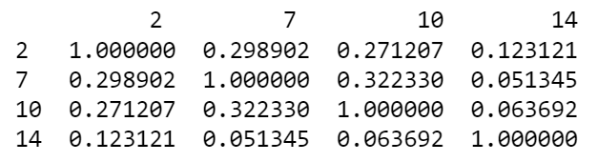
STEP 3: SPLITTING the data set
Now, we will split our data into train set and test set to prepare our data for two different phases of machine learning modeling: training and testing.
Also, features like DriversLicense (11) and ZipCode (13) are not as important as the other features in the dataset for predicting credit card approvals. To get a better sense, we can measure their statistical correlation to the labels of the dataset. We should drop them to design our machine learning model with the best set of features. In Data Science literature, this is often referred to as feature selection.
from sklearn.model_selection import train_test_split
print(cc_apps.corr(numeric_only = True))
#Drop the features 11 and 13
cc_apps = cc_apps.drop([11, 13], axis=1)
# Split into train and test sets
cc_apps_train, cc_apps_test = train_test_split(cc_apps, test_size=0.33, random_state=42)

Slide 23
STEP 4: Handling the missing values (1)
Now we've split our data, we can handle some of the issues we identified when inspecting the DataFrame, including:
Our dataset contains both numeric and non-numeric data (specifically data that are of float64, int64 and object types). Specifically, the features 2, 7, 10 and 14 contain numeric values (of types float64, float64, int64 and int64 respectively) and all the other features contain non-numeric values.
The dataset also contains values from several ranges. Some features have a value range of 0 - 28, some have a range of 2 - 67, and some have a range of 1017 - 100000. Apart from these, we can get useful statistical information (like mean, max, and min) about the features that have numerical values.
Finally, the dataset has missing values, which we'll take care of it. The missing values in the dataset are labeled with '?', which can be seen in the last cell's output of step 2.
Now, let's temporarily replace these missing value question marks (?) with NaN.
# Import numpy
import numpy as np
# Replace the '?'s with NaN in the train and test sets
cc_apps_train = cc_apps_train.replace('?', np.NaN)
cc_apps_test = cc_apps_test.replace('?', np.NaN)
print(cc_apps_train)

Slide 24
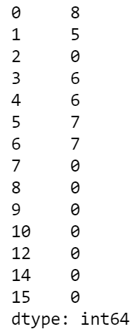
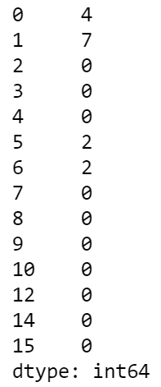
STEP 4: Handling the missing values (2)
We replaced all the question marks with NaNs. This is going to help us in the next missing value treatment that we are going to perform.
An important question that gets raised here is why are we giving so much importance to missing values? Can't they be just ignored? Ignoring missing values can affect the performance of a machine learning model heavily. While ignoring the missing values, our machine learning model may miss out on information about the dataset that may be useful for its training.
So, to avoid this problem, we are going to impute the missing values with a strategy called mean imputation.
# Impute the missing values with mean imputation
cc_apps_train.fillna(cc_apps_train.mean(numeric_only = True), inplace=True)
cc_apps_test.fillna(cc_apps_train.mean(……), inplace=True)
# Count the number of NaNs in the datasets and print the counts to verify
print(cc_apps_train.isnull().sum())
print(cc_apps_test.isnull().sum())

Slide 25
STEP 4: Handling the missing values (3)
We have successfully taken care of the missing values present in the numeric columns. There are still some missing values to be imputed for columns 0, 1, 3, 4, 5, and 6. All of these columns contain non-numeric data, and this is why the mean imputation strategy would not work here. This needs a different treatment.
We are going to impute these missing values with the most frequent values as present in the respective columns. This is good practice when it comes to imputing missing values for categorical data in general.
for col in cc_apps_train.columns: # Iterate over each column of cc_apps_train
if cc_apps_train[col].dtypes == 'object': # Check if the column is of object type
# Impute with the most frequent value
# The value_counts() function returns a Series that contain counts of unique values. It returns an object that will be in
# descending order so that its first element will be the most frequently-occurred element.
cc_apps_train = cc_apps_train.fillna(cc_apps_train[col].value_counts().index[0])
cc_apps_test = cc_apps_test.fillna(cc_apps_train[col].value_counts().index[0])
# Count the number of NaNs in the dataset and print the counts to verify
print(cc_apps_train.isnull().sum())
print(cc_apps_test.isnull().sum())
# At this point, there is no missing values.

Slide 26

STEP 5: Preprocessing the data
The missing values are now successfully handled.
There is still some minor but essential data preprocessing needed before we proceed towards building our machine learning model. We are going to divide these remaining preprocessing steps into two main tasks:
Convert the non-numeric data into numeric.
Scale the feature values to a uniform range.
First, we will be converting all the non-numeric values into numeric ones. We do this because not only it results in a faster computation but also many machine learning models require the data to be in a strictly numeric format. We will do this by using the get_dummies() method from pandas.
# Convert the categorical features in the train and test sets independently
print(cc_apps_train)
cc_apps_train = pd.get_dummies(cc_apps_train) # try with argument dtype = int
cc_apps_test = pd.get_dummies(cc_apps_test)
print(cc_apps_train)
# Reindex the columns of the test set aligning with the train set
cc_apps_test = cc_apps_test.reindex(columns=cc_apps_train.columns, fill_value=0)

Slide 27
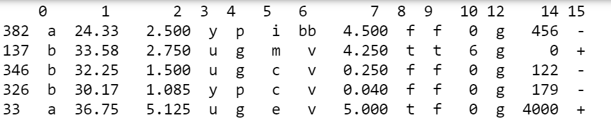
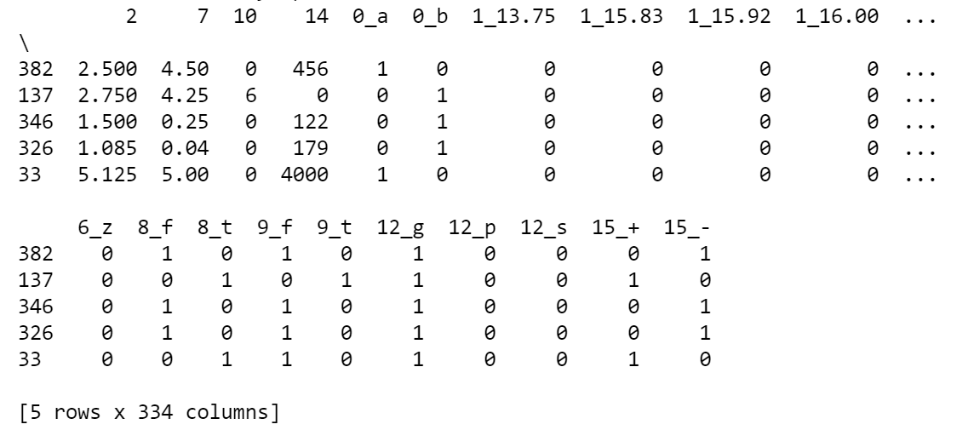
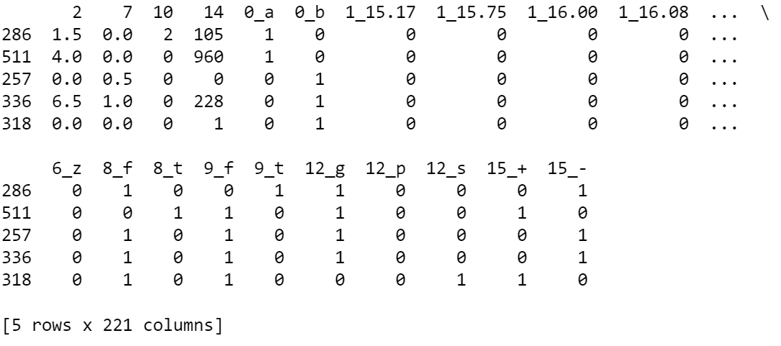
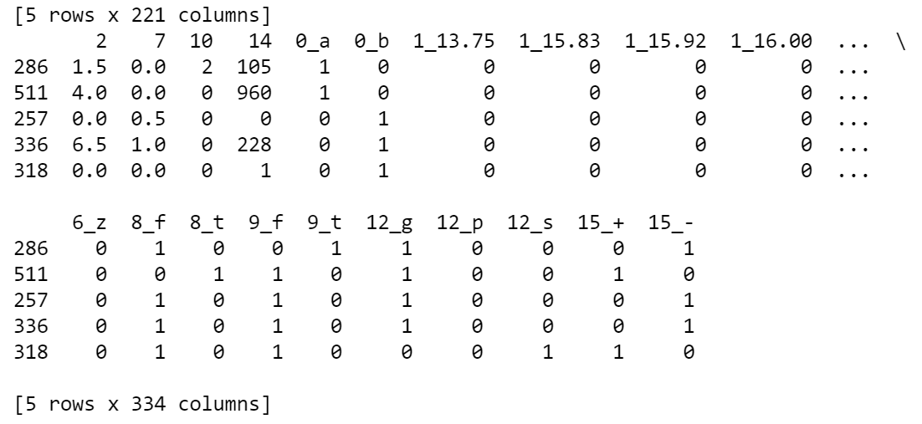
Train data
Test data after columns alignment
Test data

Slide 28
STEP 5: Preprocessing the data (2)
Now, we are only left with one final preprocessing step of scaling before we can fit a machine learning model to the data.
Now, let's try to understand what these scaled values mean in the real world. Let's use CreditScore as an example. The credit score of a person is their creditworthiness based on their credit history. The higher this number, the more financially trustworthy a person is considered to be. So, a CreditScore of 1 is the highest since we're rescaling all the values to the range of 0-1.
# Import MinMaxScaler
from sklearn.preprocessing import MinMaxScaler
# Segregate features and labels into separate variables
X_train, y_train = cc_apps_train.iloc[:, :-1].values, cc_apps_train.iloc[:, [-1]].values
X_test, y_test = cc_apps_test.iloc[:, :-1].values, cc_apps_test.iloc[:, [-1]].values
# Instantiate MinMaxScaler and use it to rescale X_train and X_test
scaler = MinMaxScaler(feature_range=(0, 1))
rescaledX_train = scaler.fit_transform(X_train)
rescaledX_test = scaler.transform(X_test)

Slide 29
STEP 6: Fit the model
Essentially, predicting if a credit card application will be approved or not is a classification task. According to UCI, our dataset contains more instances that correspond to "Denied" status than instances corresponding to "Approved" status. Specifically, out of 690 instances, there are 383 (55.5%) applications that got denied and 307 (44.5%) applications that got approved.
This gives us a benchmark. A good machine learning model should be able to accurately predict the status of the applications with respect to these statistics.
Which model should we pick? A question to ask is: are the features that affect the credit card approval decision process correlated with each other? We can measure correlation. Because of this correlation, we'll take advantage of the fact that generalized linear models perform well in these cases. Let’s use a Logistic Regression model (a generalized linear model).
# Import LogisticRegression
from sklearn.linear_model import LogisticRegression
# Instantiate a LogisticRegression classifier with default parameter values
logreg = LogisticRegression()
# Fit logreg to the train set
logreg.fit(rescaledX_train,y_train)

Slide 30
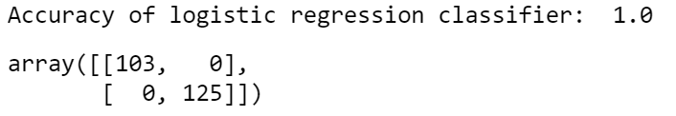
STEP 7: Make the predictions
We will now evaluate our model on the test set with respect to classification accuracy. But we will also take a look the model's confusion matrix. In the case of predicting credit card applications, it is important to see if our machine learning model is equally capable of predicting approved and denied status, in line with the frequency of these labels in our original dataset.
If our model is not performing well in this aspect, then it might end up approving the application that should have been approved. The confusion matrix helps us to view our model's performance from these aspects.
# Import confusion_matrix
from sklearn.metrics import confusion_matrix
# Use logreg to predict instances from the test set and store it
y_pred = logreg.predict(rescaledX_test)
# Get the accuracy score of logreg model and print it
print("Accuracy of logistic regression classifier: ", logreg.score(rescaledX_test,y_test))
# Print the confusion matrix of the logreg model
confusion_matrix(y_test,y_pred)

Slide 31
IN-CLASS TASKS
TASK 1:
Change an ML model to KNN and see how KNN performs. Try to find the best k.
Try both approaches

Slide 32
Hyperparameter tuning
param_grid = {'n_neighbors': np.arange(1, 11),
'weights': ['uniform', 'distance'],
'algorithm': ['auto', 'ball_tree', 'kd_tree', 'brute'],
'p': [1, 2]}
# Define the KNN classifier
knn = KNeighborsClassifier()
# Define the grid search object
grid = GridSearchCV(knn, param_grid, cv=5, scoring='accuracy')
print("Best Hyperparameters:", grid.best_params_)
print("Best Accuracy:", grid.best_score_)

